Slide 1
Forum Notes 12 August 2022

Slide 2
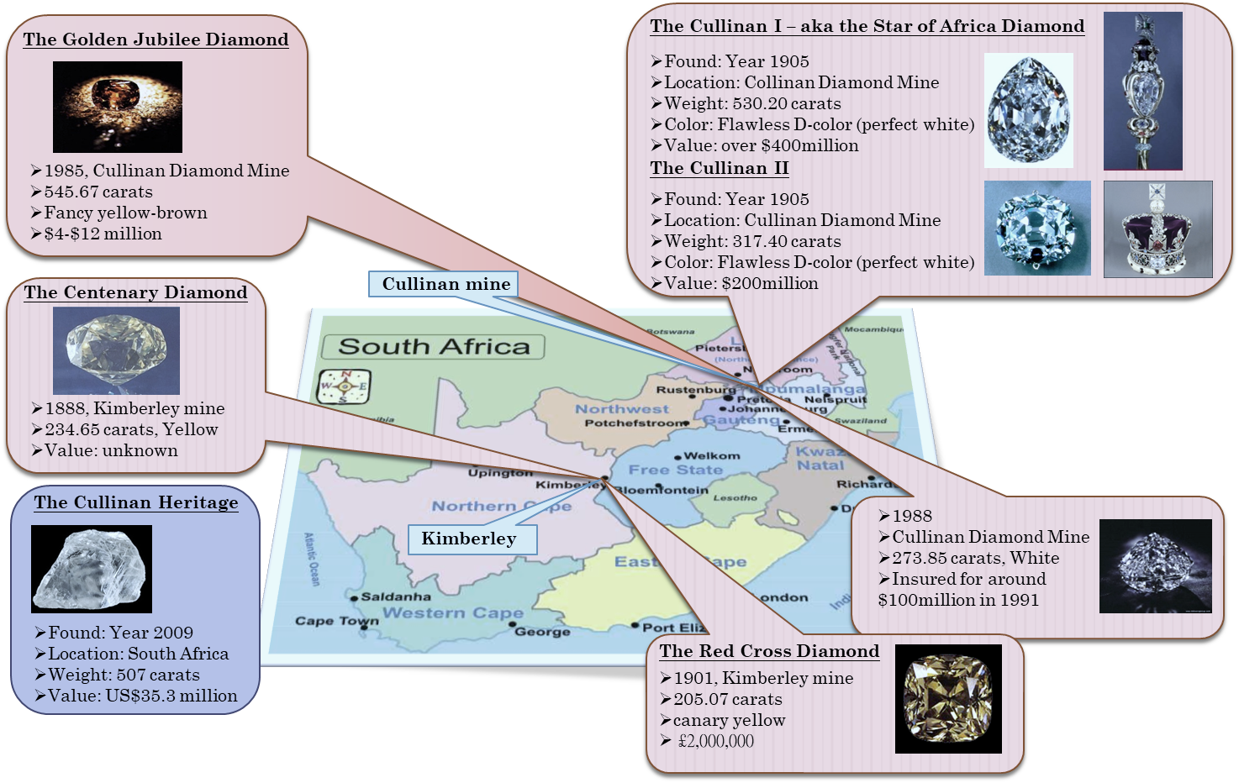
Kimberley, South Africa – Diamond City of the World

Slide 3
4C’s of a Diamond – Colour, Carat, Clarity, Cut

Slide 4
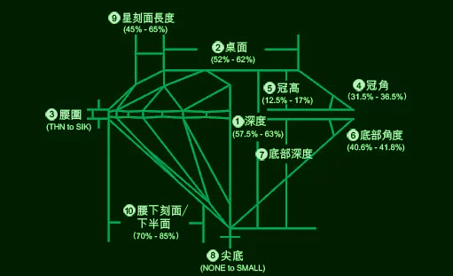
4C’s of a Diamond – Colour, Carat, Clarity, Cut

Slide 5
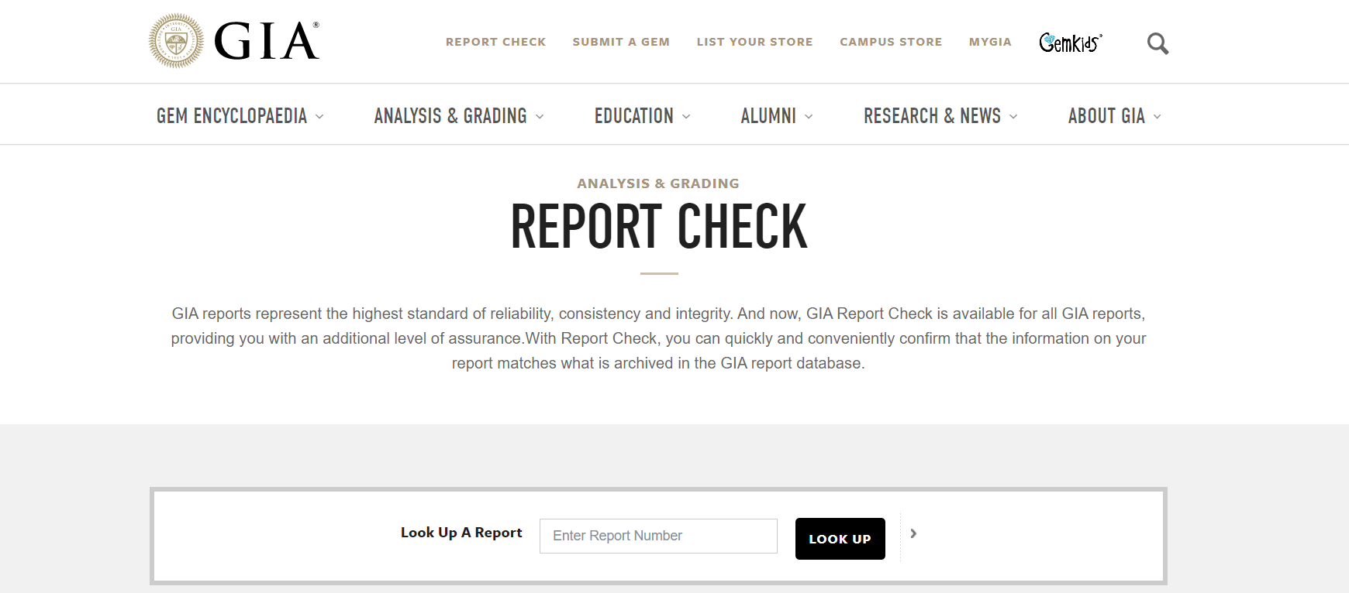
GIA Report Check for all GIA reports

Slide 6
Rough Diamond Price Index (52 weeks)
52 week high 207.3

Slide 7
SSC Frank Smith Diamonds GIA certified

Slide 8
The Diamond Production Supply Chain -
A highly specialised and regulated supply chain

Slide 9
Our Charitable Mission
To support underprivileged communities in Africa

Slide 10
